Slide 1

YAY! - Celebrating Education

Slide 2
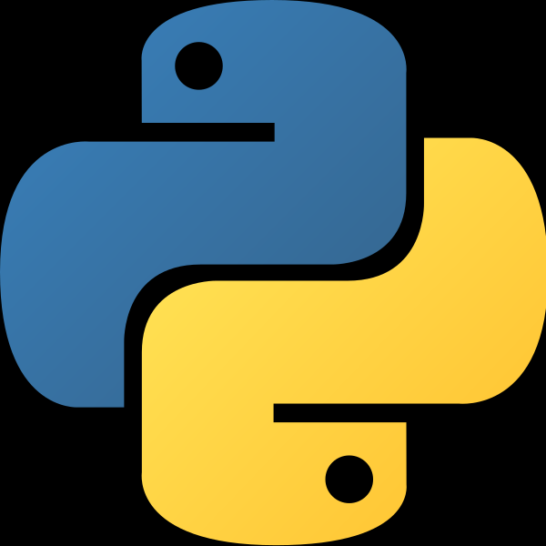
Welcome to the YAY's Python Course
(Basics)

Slide 3
Day 2

Slide 4
Course Agenda for Today?
Day 1 Problems Discussions
Arithmetic Operations (Contd..)
User Inputs
String
Escape Sequence
Indexing & Slicing in Python
String Formatting & Operations
Sample Program to print a Greetings Message

Slide 5
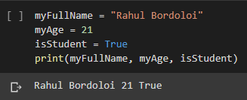
Day 1 Problem Discussion
Q1. WAP to Display your Full Name, your Age, and whether you’re a Student or not.
Here,
myFullName is a string type variable,
myAge is a integer type variable,
isStudent is a boolean type variable.
Concepts being used Here -
variables
different datatypes of variables
print() statement to print out values into the console

Slide 6
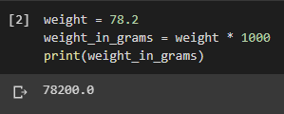
Day 1 Problem Discussion
Q2. WAP to convert a given weight (in kgs) into grams and print it on the terminal.
Here,
weight is a integer type variable,
weight_in_grams is a float type variable (why??),
Concepts being used Here -
variables
variable typecasting
print() statement to print out value into the console

Slide 7
Arithmatic Operations (Contd..)
As demonstarted yesterday, arithmatic operations in Python are analogous to that of general Mathematics.
Regarding, Operator Precedence, we use :
BODMAS (Bracket-Of-Division-Multiplication-Addition-Substraction) Rule here.
What's the Anser to this Equation :

Slide 8
User Inputs
Developers often have a need to interact with users, either to get data or to provide some sort of result. Most programs today use a dialog box as a way of asking the user to provide some type of input.
input() function first takes the input from the user and then evaluates the expression, which means Python automatically identifies whether user entered a string or a number or list.
Note :
Python stops executing when it comes to the input() function, and continues when the user has given some input.
If you don't typecast the variable in which you're taking in the input, the datatype of it will be a string by default.

Slide 9

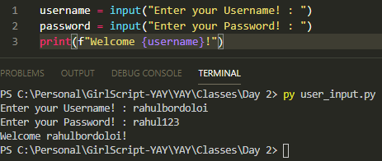
User Inputs
What the User sees
What the Developer sees.

Slide 10
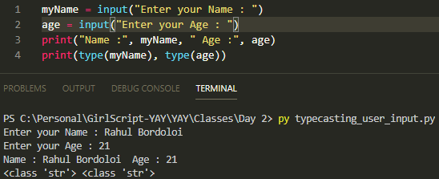
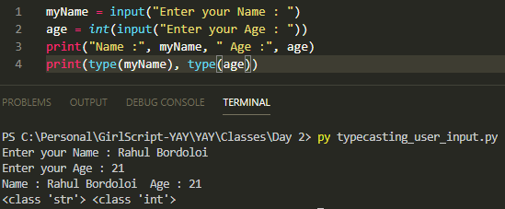
Typecasting User Inputs
When you don't use typecasting for your variable
When you use typecasting for your variable

Slide 11

Handson Exercise - I
WAP to ask two Questions : A Person's Name and his/her favourite colour.
And then print both the variable in the console.
The Output should be somewhat like this.

Slide 12

Strings
A String is a list of characters in order.
A String in python can be enclosed within '' (single quotes) or “” (double quotes).
For a Multiline String we use ''' '''' (Triple Quotes).
These are examples of Python Strings.

Slide 13

Escape Sequence
Escape Sequence is a special type of character that's there in your keyboard but you cannot type it in the screen. Eg - Enter, Space, Tab etc.
Escape Sequence are represented with a backslash notation.
Some of the Commonly used Escape Sequences.

Slide 14

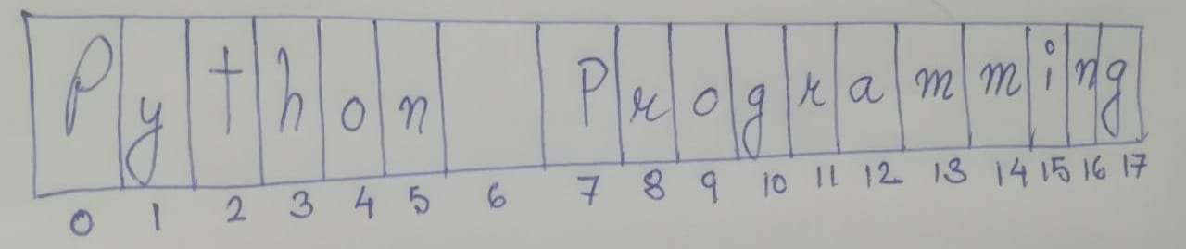
Indexing in Python
Suppose I've a string myThought.
And that's how it is being represented in the Memory

Slide 15
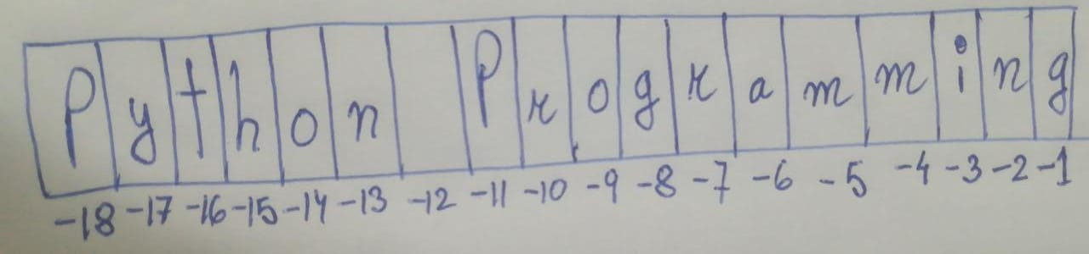
Indexing in Python
Python follows 0-indexing ie indexing starts from 0 to n-1, where n is the number of characters of a string or a contiguous memory container.
Python also has a special characteristic that it also follows -1-indexing ie indexing from the back (from -1 to -n, where n is the length of the container).
Example of -1-indexing

Slide 16
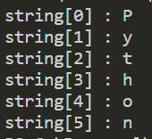
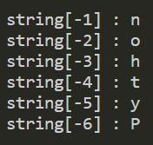
Indexing in Python
Suppose I've a String,
Example of 0-indexing
Example of -1-indexing

Slide 17




Slicing in Python
Syntax for Slicing :
Remember,
starting_index is always inclusive
ending_index is exclusive, ie it'll slice the number just below the ending_index
stride is the number of steps in our slice notation
Example 1 Example 2 Example 3

Slide 18
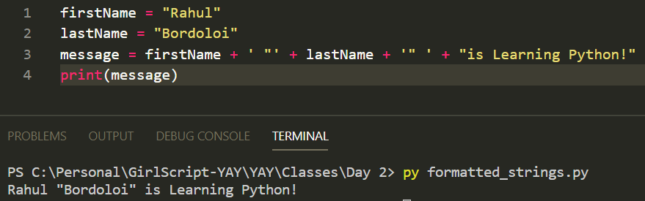
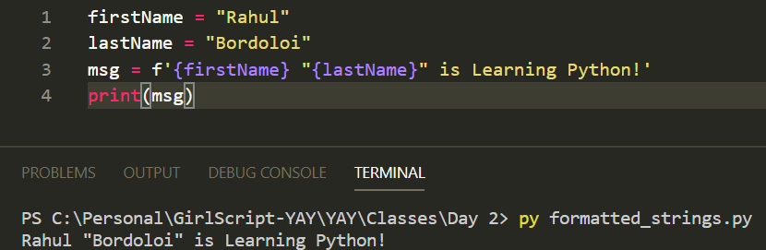
String Formatting
Simple String Concatenation
f-String

Slide 19
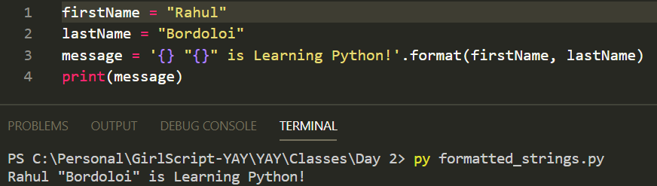
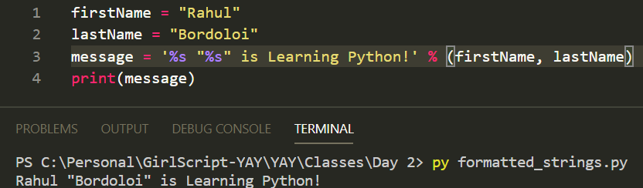
String Formatting
String Formatting using format()
String Formatting using %s (string formatting operator)

Slide 20
String Formatting
String Formatting using %s (string formatting operator)
Python uses C-style string formatting to create new, formatted strings. The "%" operator is used to format a set of variables enclosed
print ("My name is %s and weight is %d kg!" % ('Zara’, 51))
https://www.tutorialspoint.com/string-formatting-operator-in-python

Slide 21



String Operations
Python has various in-built methods and functions to help us fallicitate the operations we want to perform on a string.
https://www.w3schools.com/python/python_strings_methods.asp
Note :
Functions are general-purpose utility code that’s not specific to a particular data-type, whereas
Methods are general-purpose utility code that’s specific to a particular data-type.
Example 1 Example 2 Example 3

Slide 22
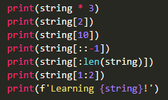
Answer These!
You're given a string :
Answer the Following Questions :

Slide 23

Handson Exercise - II
WAP to ask two Questions : A Person's Name and his/her favourite colour.
And then print a message as “Rahul likes Blue” into the console.
The Output should be somewhat like this.

Slide 24
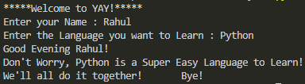
Sample Program to print a Greetings Message
The Output should be looking like this.
Note : Rahul and Python are user-inputs.

Slide 25
Thank You
See you on Day 3!

